Slide 1
Lesson 8
Data Exploration and Analysis II
EM384

Slide 2
Lesson 8
L8
LESSON OBJECTIVE #1
Understand the Python pandas DataFrame data structure.
L8
LESSON OBJECTIVE #2
Generate a DataFrame from a CSV file.
L8
LESSON OBJECTIVE #3
Generate summary statistics for data in Python
L8
LESSON OBJECTIVE #4
Filter a pandas DataFrame using [ ] and conditionals.

Slide 3
What is pandas?
“pandas is a Python package providing fast, flexible, and expressive data structures designed to make working with “relational” or “labeled” data both easy and intuitive. It aims to be the fundamental high-level building block for doing practical, real-world data analysis in Python. Additionally, it has the broader goal of becoming the most powerful and flexible open source data analysis/manipulation tool available in any language. It is already well on its way toward this goal.”
https://pandas.pydata.org/docs/getting_started/overview.html

Slide 4

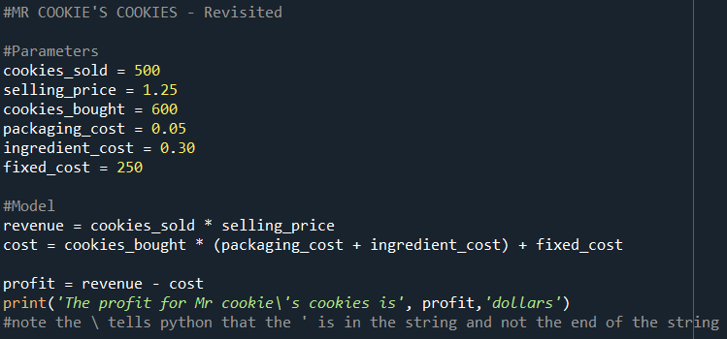

Slide 5

Add calculated columns to a DataFrame
Let’s look at the % of calories that come from fat, protein, and carbos in each cereal by adding three calculated columns to the df_cereal DataFrame.
Is this easier or harder than Excel?

Slide 6
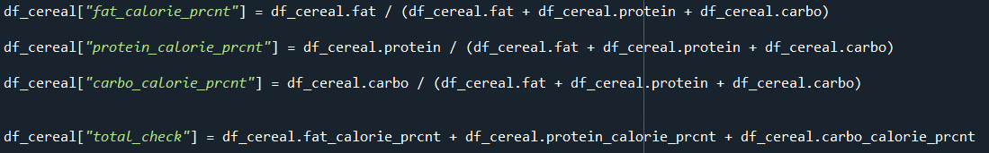

Slide 7
>>> Remember when we made this pivot table in the tutorial to calculate the arithmetic means for all of the numeric metrics, by Manufacturer?
>>> Re-run the same exact command to create the pivot table DataFrame. Is there anything different about the results?

Slide 8

Sort a DataFrame by one or more columns
Using “% of calories from fat” as our proxy for how healthy a cereal is, what are the ten least healthy cereals in the dataset?
Is there an easy way to get the answer with one line of code using pandas .sort_values( ) and .iloc[ ] ? Hint, the answer is yes.

Slide 9
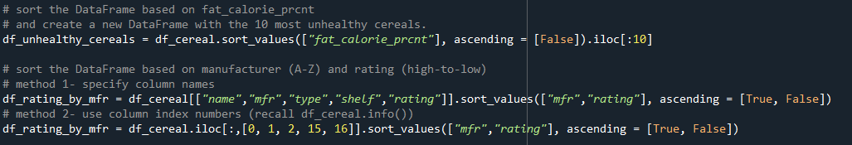

Slide 10
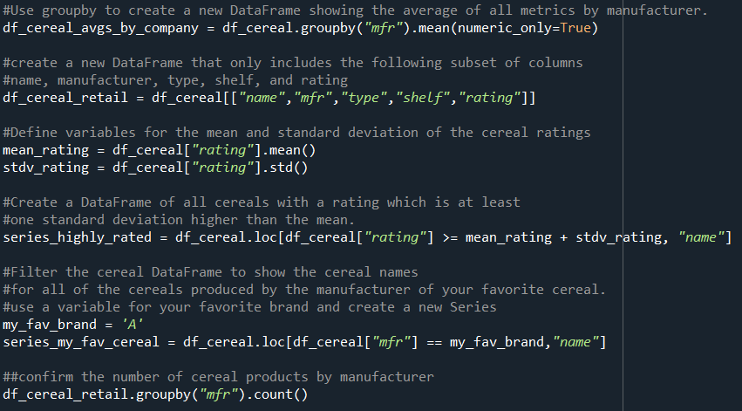
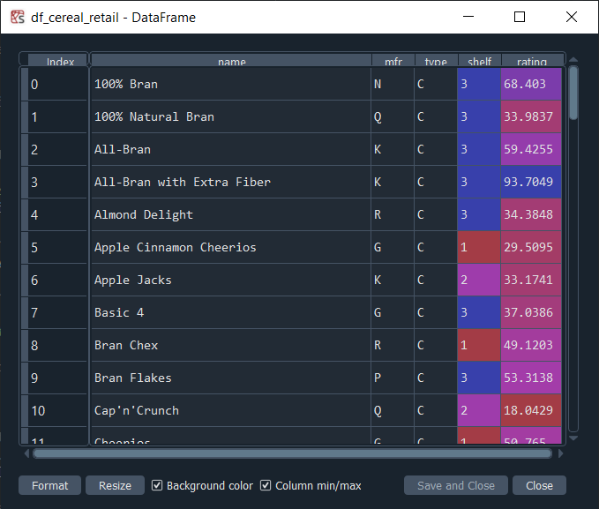

Slide 11
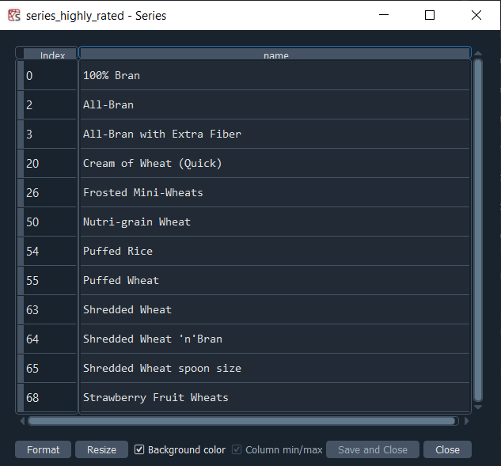
Notes:
Is your favorite cereal included in this list of highly rated cereals?

Slide 12
Create a scatter plot from a DataFrame
The marketing people think there might be a positive relationship between people’s preferences (ratings of cereals) and the amount of sugar content. What are you seeing in the data?
Let’s use the simple pandas plot functionality to create a scatter plot.

Slide 13
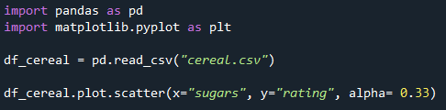

Slide 14
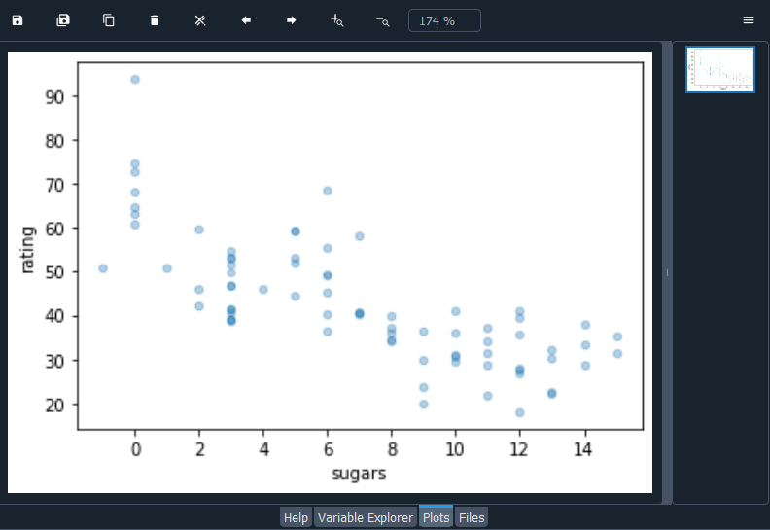
?

Slide 15
Read these tutorials at pandas.pydata.org
What kind of data does pandas handle?
How do I read and write tabular data?
How do I select a subset of a DataFrame?
How to calculate summary statistics?
How to create new columns derived from existing columns?
How do I create plots in pandas?

Slide 16
More learning
For anything you need to know about what pandas can do and how to use it, pandas.pydata.org maintains on online user guide:
https://pandas.pydata.org/docs/user_guide/index.html#user-guide
As far as documentation goes, this user guide (in addition to the other tutorials and technical content available on the website) set a very high standard for accessibility, completeness, and ease of use.
This makes working with data in Python easy and enjoyable.

Slide 17
Next Time…
Homework Set 2 Due
Homework Set 3 Assigned
Read Chapter 3.1 (pages 32-35, stop at Graphical Solution)
Lesson 9: Introduction to Linear Programs!
Understand the characteristics of linear programming as a subset of optimization.
Formulate a linear program algebraically.
Identify the three parts to a linear program: Objective Function, Decision Variables, and Constraints.

Slide 18
Slides from pandas tutorial video
EM384 pandas tutorial video.mp4

Slide 19
What is pandas?
“pandas is a Python package providing fast, flexible, and expressive data structures designed to make working with “relational” or “labeled” data both easy and intuitive. It aims to be the fundamental high-level building block for doing practical, real-world data analysis in Python. Additionally, it has the broader goal of becoming the most powerful and flexible open source data analysis/manipulation tool available in any language. It is already well on its way toward this goal.”
https://pandas.pydata.org/docs/getting_started/overview.html

Slide 20
1. Import data from Desktop.
Download data from Teams in Lesson 8 Folders.
Confirm your working directory.
Import the pandas package.
Notes:
The cereal.csv dataset can also be downloaded from the Lesson 8 folder in Microsoft Teams.

Slide 21
link to cereal.csv

Slide 22
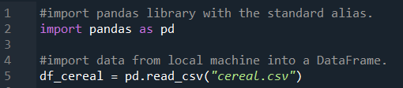

Slide 23

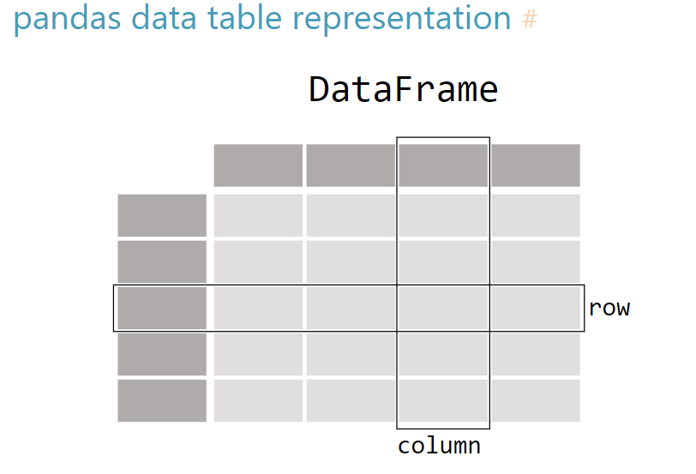
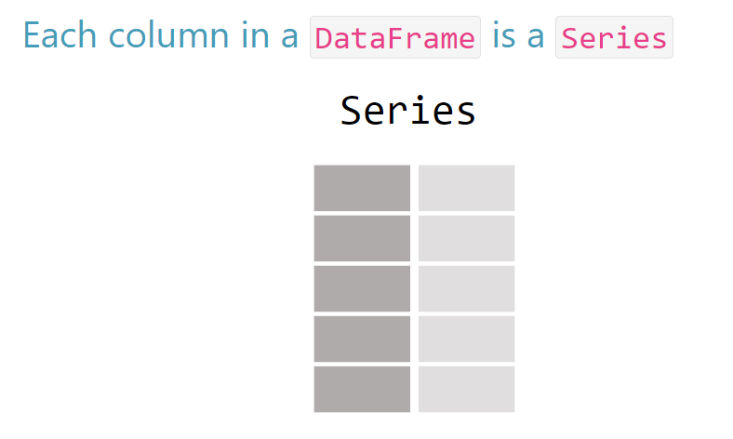
2. pandas DataFrame data structure
https://pandas.pydata.org/docs/getting_started/intro_tutorials/01_table_oriented.html#pandas-data-table-representation

Slide 24

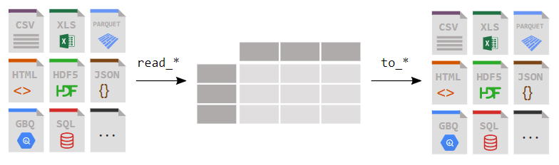
3. Create a DataFrame from a csv file
https://pandas.pydata.org/docs/getting_started/intro_tutorials/02_read_write.html

Slide 25
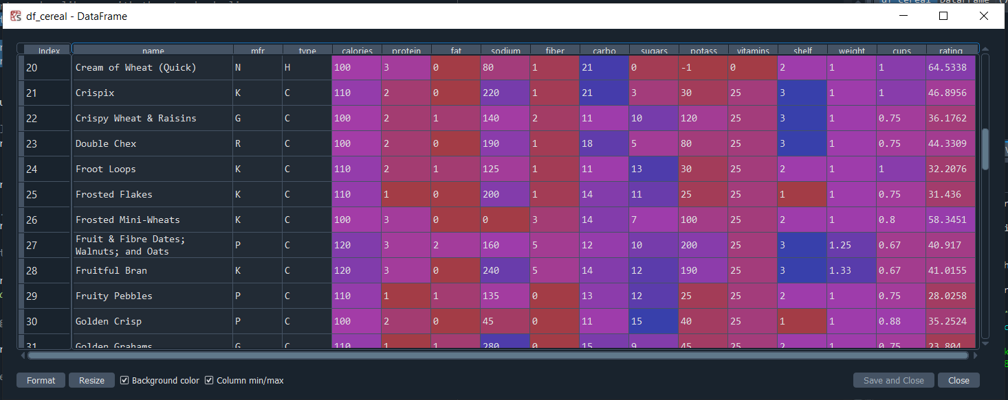

Slide 26
4. We have a DataFrame.
Congratulations, you’ve just created a fresh new pandas DataFrame!
Now you can get to work with your data in Python using pandas.
By learning this package and practicing with it, you’ll be able to do nearly anything you need to do with data of all shapes and sizes.

Slide 27
5. What data are we working with?
Display the first ten records in the console.
Display the columns and their data types.
View high-level information about the DataFrame’s contents.

Slide 28
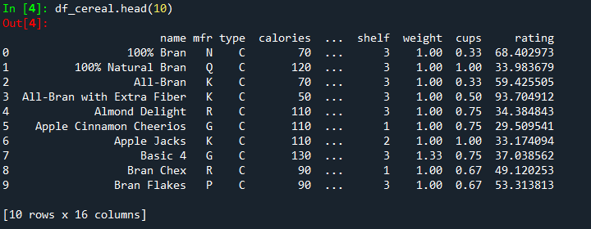

Slide 29
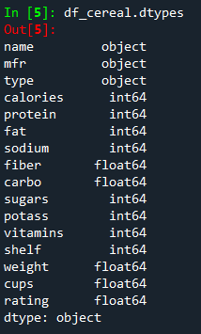
Notes:
What is an object data type in pandas?

Slide 30
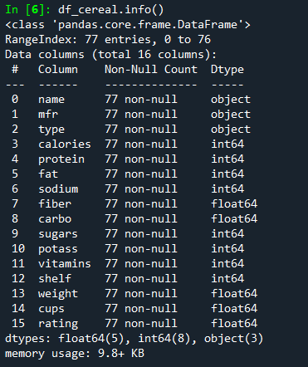

Slide 31
6. Let’s generate some summary statistics
We can quickly generate summary statistics about each of the cereals represented in the DataFrame using the .describe() function.
If you are unsure about the quality of your data, summary statistics are a good place to start!
We can also aggregate the data and calculate summary statistics for all the cereals produced by the same manufacturer.

Slide 32

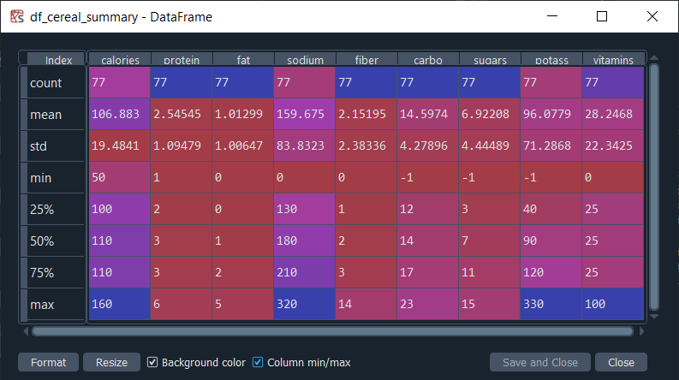
Notes:
Do you notice something in the data that could possibly be problematic?

Slide 33
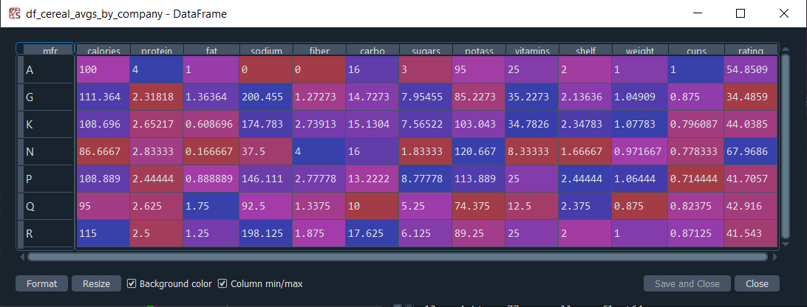

Slide 34
Notes:
What is the mean and standard deviation of the “rating” column in the cereal DataFrame?

Slide 35
7. Filter a pandas DataFrame
Filter the cereal DataFrame to only include the names of the cereals produced by the manufacturer of your favorite cereal.
Create a series that only includes the names of cereals which have a rating that is at least one standard deviation above the mean.

Slide 36
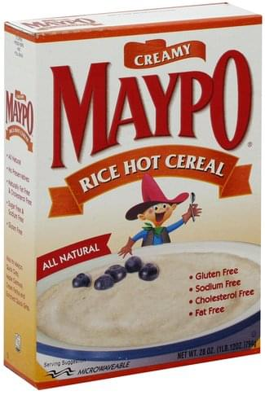
https://www.innit.com/public/products/images/00835882005016-0Q1t9SyRz3tUJw-0_s500.jpg
Notes:
What’s your favorite? Find it in the dataset and make note of the manufacturer’s code.

Slide 37
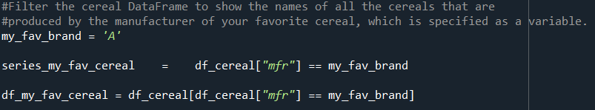
>>> What is the difference between the outputs?
Notes:
What is the difference between these two approaches?

Slide 38
Notes:
Is your favorite cereal included in this list of highly rated cereals?

Slide 41
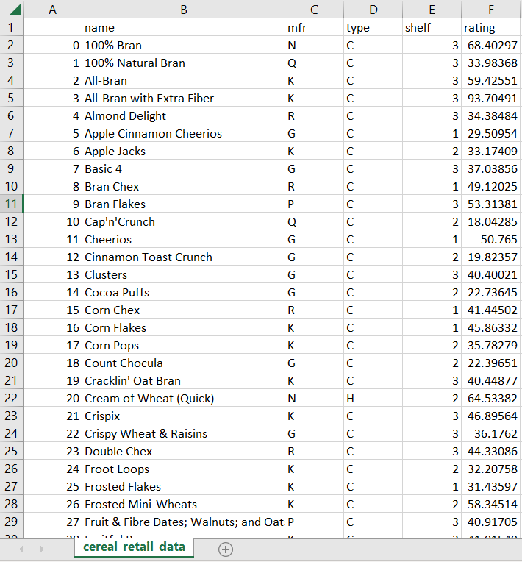

Slide 42
8. Save your script.
As “EM384_pandas_cereal_tutorial.py”
We’ll come back to it later.
Notes:
By completing this tutorial, you are well on your way to becoming a true EM384 warrior.

